Slide 1
Nation of Neighbors PJ Rey University of Maryland pjrey.socy@gmail.com
PJ Rey (@pjrey)

Slide 2
Nation of Neighbors:
PJ Rey (@pjrey)

Slide 3
Nation of Neighbors: Background
PJ Rey (@pjrey)

Slide 4
Nation of Neighbors
local site launched, initially, in 2005 as “Watch Jefferson County”
platform re-launched, nationally, in 2009, under current name
allows for anonymous crime reporting
users can receive messages via real-time text or email, digest , or through the browser interface
users define the boundaries of their own communities using an app adapted from Google maps
PJ Rey (@pjrey)

Slide 5
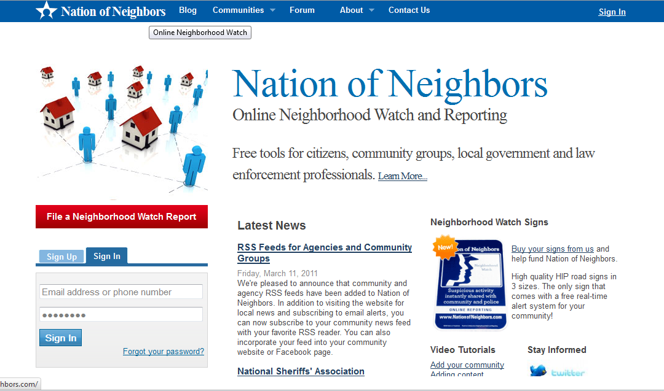
Nation of Neighbors
PJ Rey (@pjrey)

Slide 6
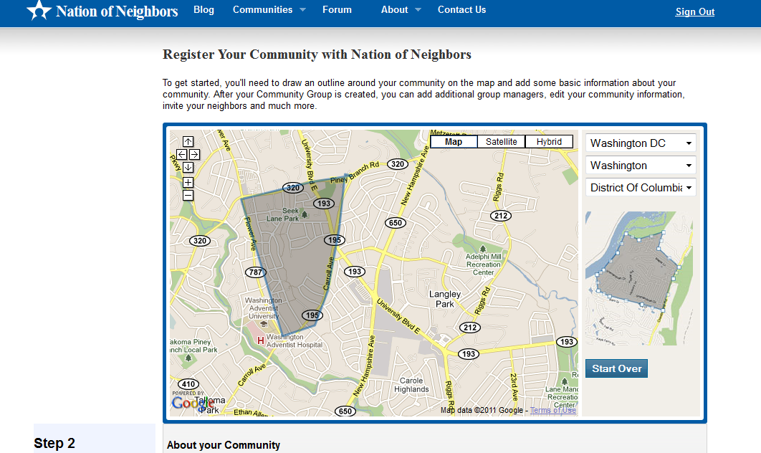
Registering a Community
PJ Rey (@pjrey)

Slide 7
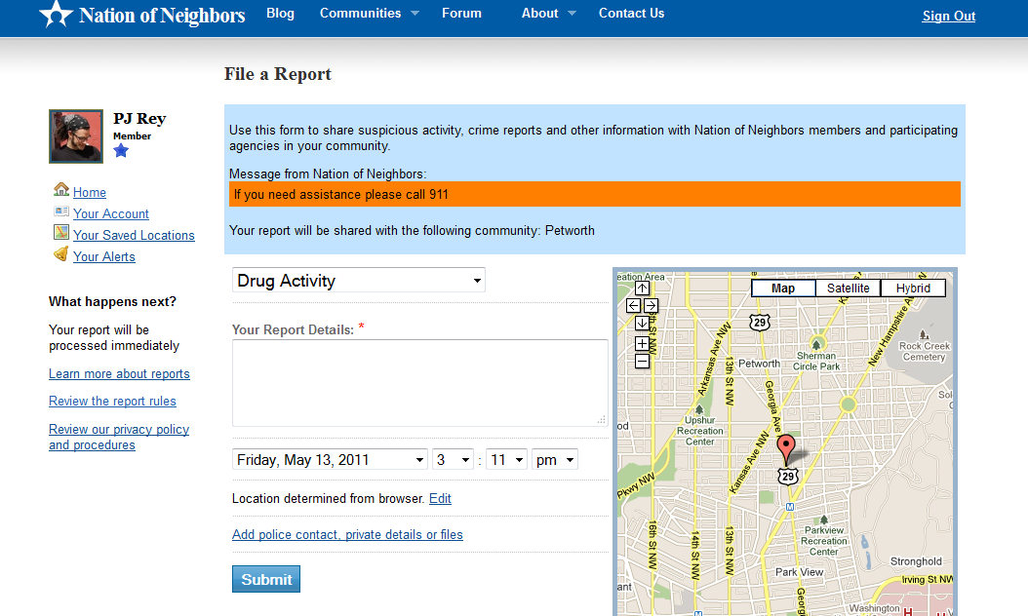
Filing Reports
PJ Rey (@pjrey)

Slide 8
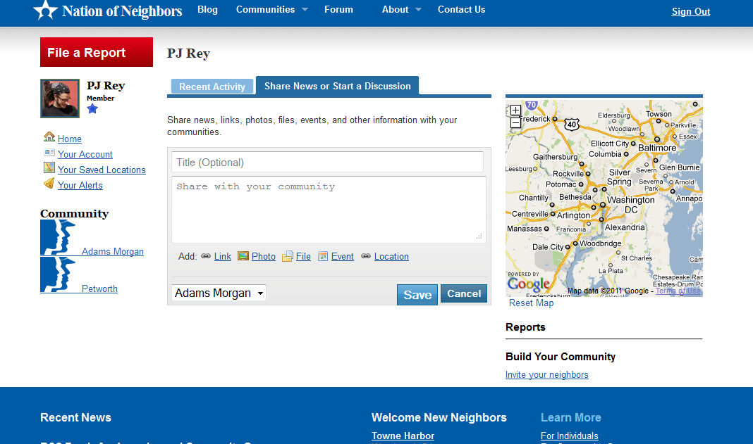
Posting Comments
PJ Rey (@pjrey)

Slide 9
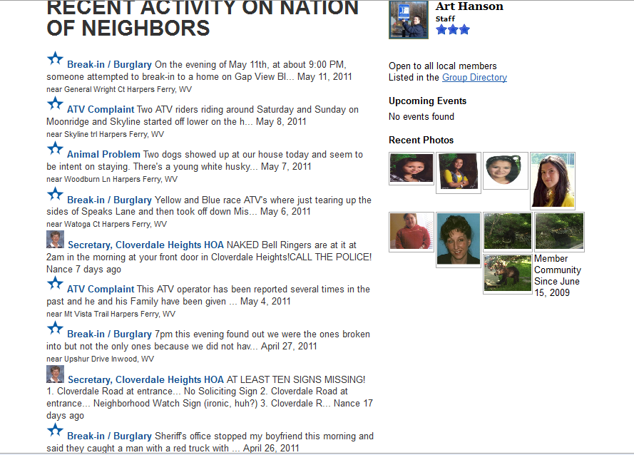
Conversation Feed
PJ Rey (@pjrey)

Slide 10
Nation of Neighbors:
PJ Rey (@pjrey)

Slide 11
Nation of Neighbors: User Motivations
PJ Rey (@pjrey)

Slide 12
Invitation Experiment
Two goals:
Orient invitation email to maximize acceptance
Better understand users’motivations for joining the site
PJ Rey (@pjrey)

Slide 13
Invitation Experiment
Four motivations for community involvement:
Egoism: benefit one-self
Altruism: benefit one or more other individuals
Collectivism: to benefit a group
Princliplism: to uphold moral principles
Batson, et al., 2002
PJ Rey (@pjrey)

Slide 14
Invitation Experiment
I’m a member of Nation of Neighbors, a website that…
helps me to be aware of crime and suspicious activity in our neighborhood. It makes me feel good to be connected with my neighbors and know that they might help me be safer too.
allows me to share information about crime and suspicious activity in our neighborhood. It makes me feel good to be able to help my neighbors and make their lives safer.
allows our neighborhood to work together to report and discuss crime and suspicious activity. It makes me feel good that I am helping to build a connected, safer, more caring community.
allows its users to contribute to justice and safety in our neighborhood by reporting crime and suspicious activity. It makes me feel good to know I am joining a group of devoted citizens who are building a better community.
PJ Rey (@pjrey)

Slide 15
Invitation Experiment
Results
Control: 27.3% acceptance
Egoism: 36.8% acceptance
Altruism: 41.9% acceptance*
Collectivism: 28.26% acceptance
Princliplism: 29.03% acceptance
difference significant at p ≤.01
PJ Rey (@pjrey)

Slide 16
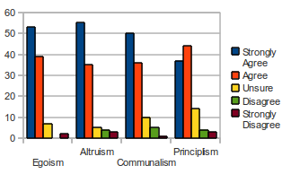
Survey
PJ Rey (@pjrey)

Slide 17
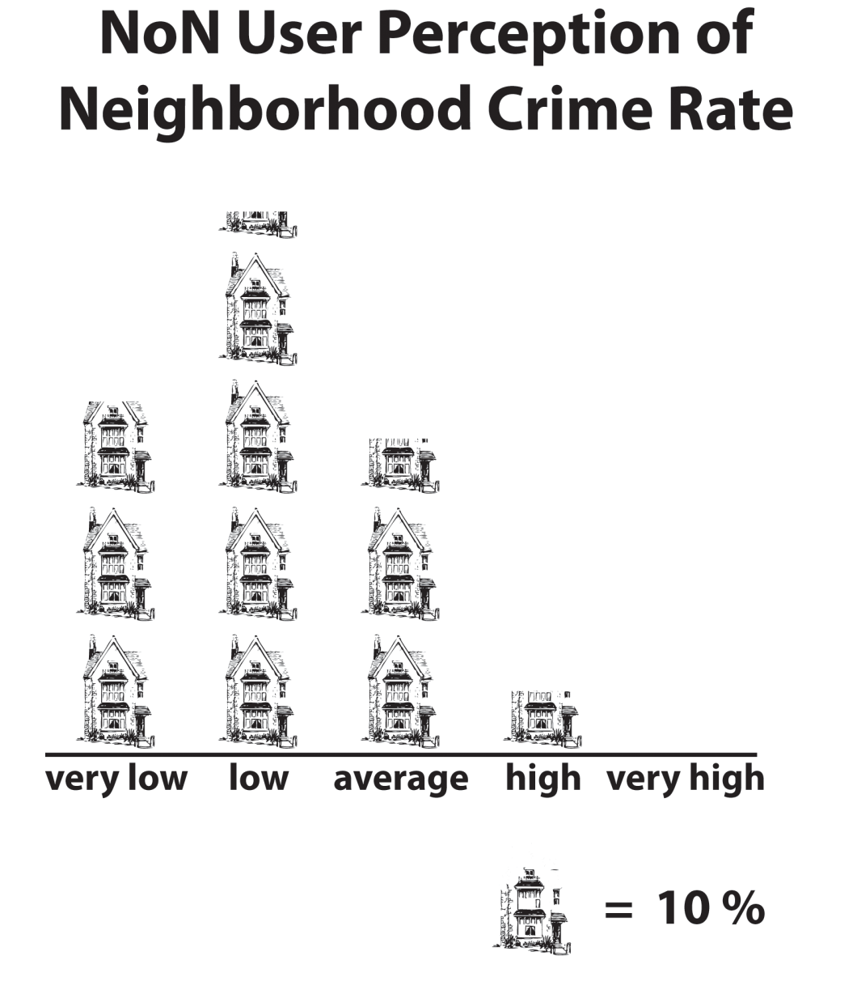
Survey
PJ Rey (@pjrey)

Slide 18
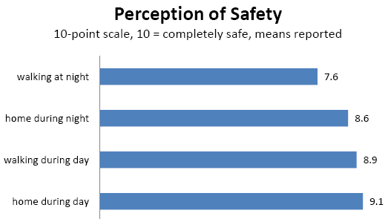
Survey
PJ Rey (@pjrey)

Slide 19
Survey
crime prevention vs. improving enforcement
capacity-building vs. immediate action
PJ Rey (@pjrey)

Slide 20
Nation of Neighbors:
PJ Rey (@pjrey)

Slide 21
Nation of Neighbors: Evaluating Success
PJ Rey (@pjrey)

Slide 22
Neighborhood Crime Watch Programs
emerged late 60s / early 70s in reaction to several high-profile violent episodes
by 1986, 1 in 5 families lived in neighborhoods with watch programs and, in those communities, 38% of families participated (Garofalo & McLeod, 1988)
these programs received sizable streams of state and federal funding
by the late 1980s, lawmakers demanded that the effectiveness of these programs be tested
The causal connection between crime watch programs and crime prevention is very difficult to establish
few studies found a significant reduction of crime after crime watch programs were introduced (Lindsay & McGillis, 1986; Rosenbaum, Lewis, & Grant, 1986; Skogan, 1990; Bennet, 1990), and those that did observed that the positive effects dissipated rapidly (Cirel et al., 1997; Lindsay & McGillis, 1986)
PJ Rey (@pjrey)

Slide 23
Nation of Neighbors
Nation of Neighbors founder, Art Hansen, and coauthor, Ben Shneiderman, (2009, p. 18), argue that
Our current economic realities are dictating reduced funding for community policing and, at the same time, creating an enhanced concern about criminal activity on the part of community members. We believe these conditions, along with the recent success and large scale acceptance of online social collaboration, make now the right time to revisit Neighborhood Watch and perhaps improve upon it by simultaneously increasing social participation and allowing anonymity via Nation of Neighbors.
PJ Rey (@pjrey)

Slide 24
Nation of Neighbors
part traditional crime watch
part online community of practice
PJ Rey (@pjrey)

Slide 25
Nation of Neighbors
Nation of Neighbors is distinct from traditional crime watch programs in important ways:
anonymity – local informants need not fear reprisal from perpetrators
network structure – eliminates the hierarchical police/block captain/participant relationship
space-time compression – of paramount importance to crime prevention because information is often only actionable for a short window after it is acquired
mediates interactions – useful in situations where communities lack the physical proximity that conventionally facilitates the informal interactions which help to strengthen social bonds
PJ Rey (@pjrey)

Slide 26
Communities of Practice
Communities of practice seek to unite people in pursuit of a specific, common purpose, but assume that efforts to achieve this purpose are augmented through the intensification of social bonds.
Wenger (1998) defines communities of practice along three dimensions:
What it is about—its joint enterprise as understood and continually renegotiated by its members
How it functions—the relationships of mutual engagement that bind members together into a social entity
What capability it has produced—the shared repertoire of communal resources (routines, sensibilities, artifacts, vocabulary, styles, etc.) that members have developed over time.
PJ Rey (@pjrey)

Slide 27
Developed vs. Developing Communities
different goals:
developed communities – primarily oriented toward building/maintaining/utilizing capacity through regular communication
developing communities – primarily oriented toward growth of membership through sending invitations
… the health metric should account for these differences
PJ Rey (@pjrey)

Slide 28
Defining Health
Health is communications activity that is appropriate, both in kind and degree, to the needs of a community in its particular stage of development.
PJ Rey (@pjrey)

Slide 29
Activity Measures
reports (describing and geo-tagging a specific crime incidence)
posts (used to discuss issues of general concern to the community)
replies (which can be made to posts, but not reports)
invitation emails sent (generated through the site to recruit new members)
invitation acceptances
PJ Rey (@pjrey)

Slide 30
Activity Measures (cont.)
A_{C} = Communication Activity = ∑ _{(reports + posts + replies)}
A_{I} = Invitation Activity = ∑ (invites sent + invites accepted)
∑ _{(A)} = Total Activity = ∑ ₍A_{C +} A_{I)}
PJ Rey (@pjrey)

Slide 31
Normalized Activity Measures
∑ _{(UM)} = Total User-Months = ∑ (months since each user registered)
M_{bar} = Mean Months Active Per User = ∑ _{(UM)} / ∑ _{(U)}
I = Interaction Intensity = ∑ _{(A)} / ∑ _{(UM)}
I′ = Interaction Intensity = I / ∑ _{(Square Miles)}
PJ Rey (@pjrey)

Slide 32
Equity
Equity can be measured as a function of reciprocity of communication across ties.
Because most communication are broadcast because user tend to make new posts rather than reply, we cannot use average number of two-way ties between users.
Instead we propose to look at the variance in activity per month per user.
E = Equity = s₍A_{C)}²
PJ Rey (@pjrey)

Slide 33
Future Work
This theoretical work provides the foundation for future inferential analysis that will, ultimately, aim to provide community administrators with insights into the factors which promote healthy communities.
For example, future research will attempt to determine whether the following contribute (either positively or negatively) to the health of online crime-prevention communities:
law enforcement involvement
perceptions of community safety
impressions of community efficacy
technological literacy
PJ Rey (@pjrey)

Slide 34
Take Away
Social media → new opportunities for community crime prevention
Nation of Neighbors = ½ neighborhood crime watch, ½ community of practice
Evaluating success requires:
new measures
new tools
Through this work, we expect to learn more about important factors influencing the development of healthy online communities.
PJ Rey (@pjrey)

Slide 35
PJ Rey pjrey.socy@gmail.com
This material is based upon work supported in part by the
National Science Foundation
Grant # IIS - 0968521
PJ Rey (@pjrey)

